Slide 1
27020 – Bioengineering BIO 1: The characteristics and physical requirements of life
Prof. Alexander K. Buell
Protein Biophysics group
DTU Bioengineering

Slide 2
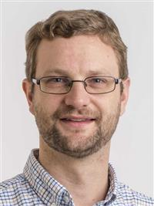
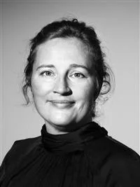
Main course organisers
Alexander K. Buell
Research interests: Protein aggregation and assembly phenomena, mostly in a biomedical
context, e.g. the molecular basis of Alzheimer’s and Parkinson’s disease
Websites:
https://www.bioengineering.dtu.dk/english/ResearchNy/Research-Sections/Section-for-Protein-Chemistry-and-Enzyme-Technology/Protein-Biophysics
www.buelllab.org
Ditte Hededam Welner
Research interests: Enzyme engineering, cell factory engineering, structural biology
Website: https://www.biosustain.dtu.dk/research/research-groups/enzyme-engineering-and-structural-biology

Slide 3
And who are you?

Slide 4
Overview over 27020 – Bioengineering
Course created in 2019, and constantly growing and evolving. Compulsory for most of DTU’s engineering students, as part of polytechnical foundation.
Aims:
to give basic notion of molecular biology to all engineers, enable the understanding of some important concepts, such as gene editing, antibody development, biotechnology, microbial ecology,…
illustrate how biology inspires engineering in a variety of disciplines, and how we are able to engineer living systems and interface biological and artificial systems
to introduce the research directions at DTU at the interface between engineering and biology

Slide 5
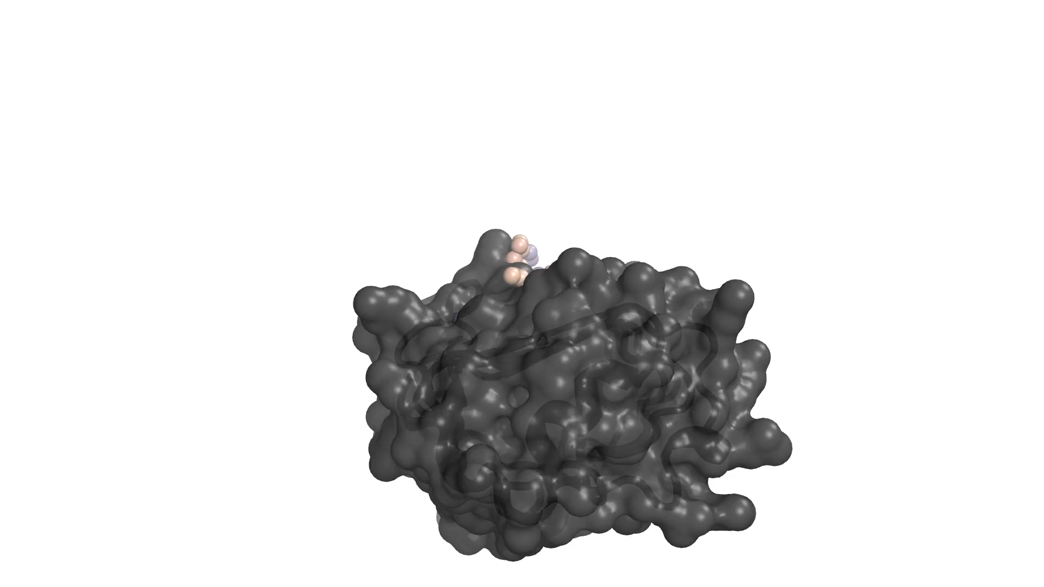
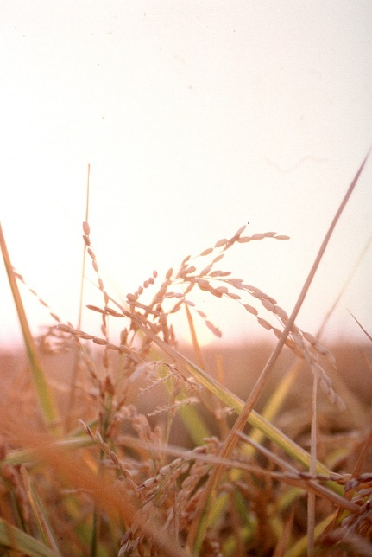
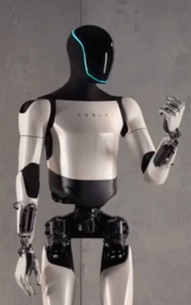
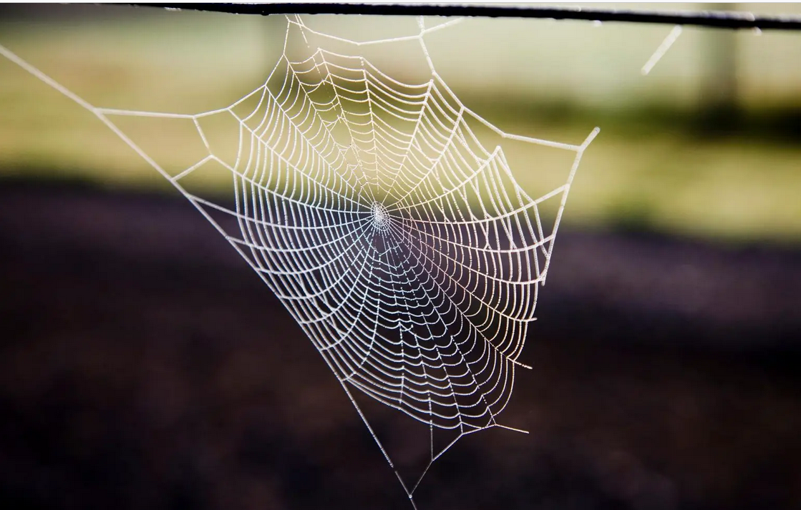
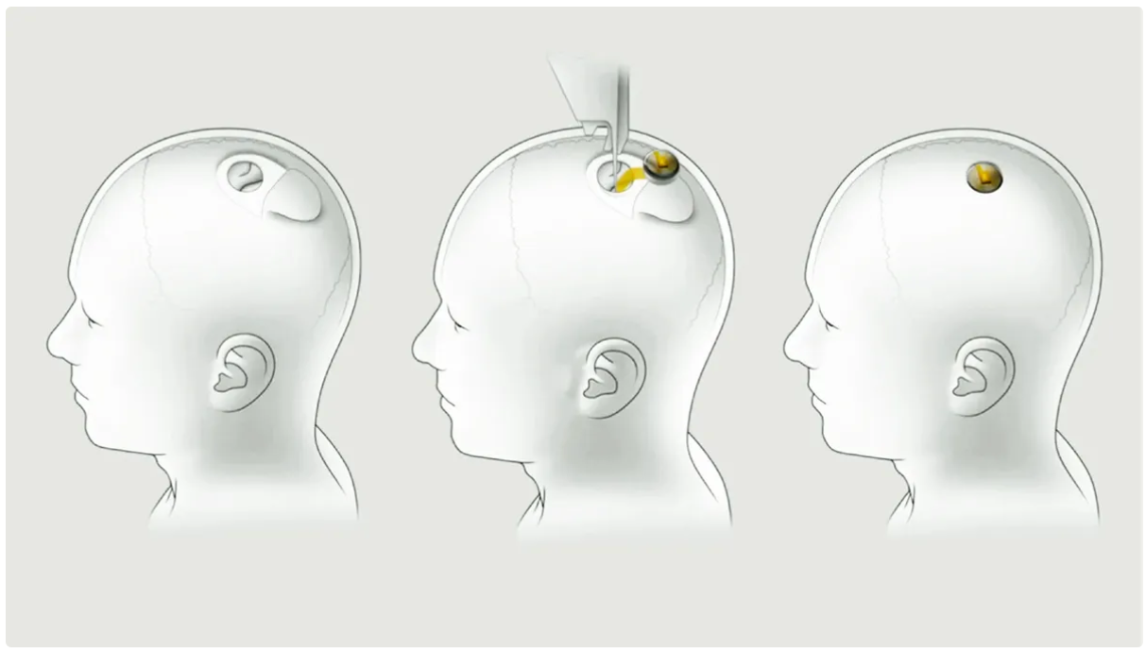
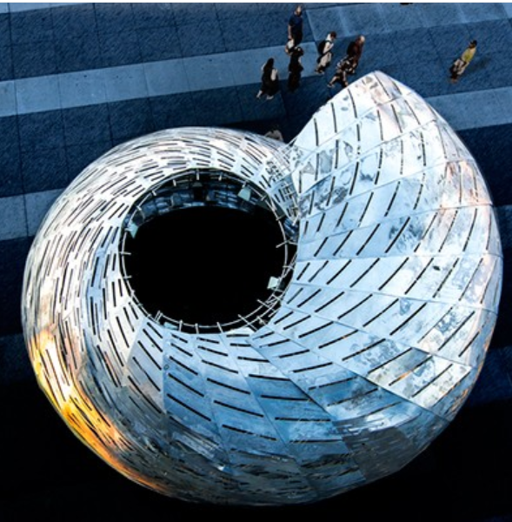
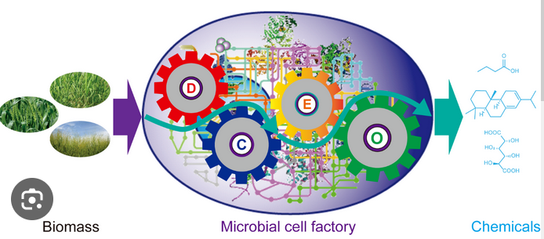
What is bioengineering?
Applications of data science, ML and AI
Biomaterials
GMOs
Robotics
Neuralink
Sensors and implants
Bioinspired design

Slide 6
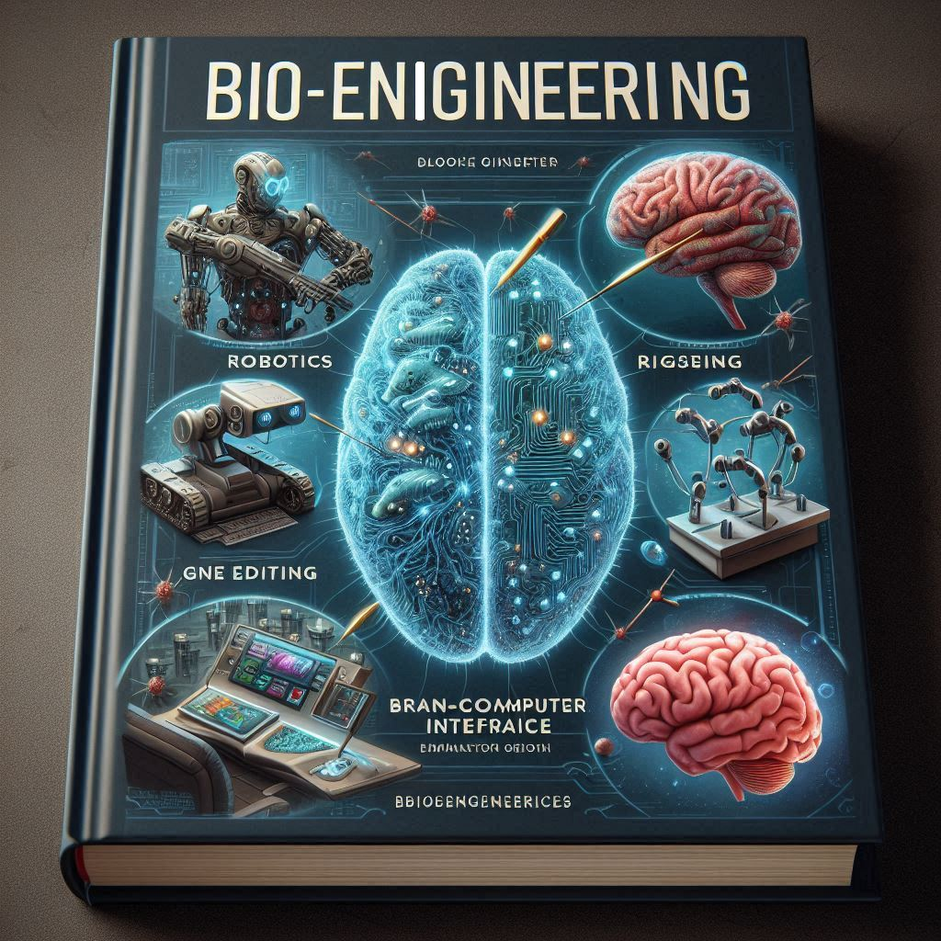
Bioengineering – too broad for a single text book?
Gene editing
Cell factory/metabolic pathway engineering
Recombinant protein production
Protein design and engineering
Biological materials and their interface with non-biological materials
Biomolecular recognition
Engineering of microbial communities
Engineering of ecosystems
Brain-computer interfaces
Robotics
Organ-on-chip
Biomimetics and bioinspired structural and mechanical design
Biological data science and machine learning

Slide 7
Overview over 27020 – Bioengineering
In autumn 2024, 8 departments + 1 center contribute to the course:
- Bioengineering
- Compute
- Energy
- Electrical Engineering
- Mechanical Engineering
- Chemical Engineering
Construct
Nanolab
Biosustain

Slide 8
Overview over 27020 – Bioengineering
After 6 weeks of general introduction for everyone, the course will split into four parallel tracks with different focus:
Bioelectronic devices - BED track
Biomaterials/Biomimetics - MIM track
Simulations and control of biological systems - SIM track
Bioengineering for the green transition – BFG track
Every student choses one track. This choice defines topic of project and (part of the) exam.
Self-enrollment to tracks starts today (2.9.2024) at 6 pm and ends on 30.9.2024 at 6pm.
Limit of the number of students per track is 100 – first come first served! Any participant not enrolled in a track will NOT be able to complete the course!
Note: NO change in track possible after the first session of the tracks (week 7 of course).

Slide 9
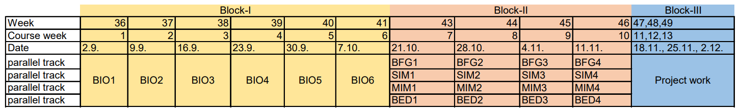
Timetable and Evaluation
Evaluation:
project (the last three weeks, interdisciplinary groups of 5 students, pass/fail)
final exam (2h, multiple choice, graded, closed internet and closed books).
The final grade for the course is the exam grade, but the report needs to be passed in order to pass the course. If the report is graded as failed, the group is given one week to revise the report.

Slide 10
Content of the first 6 weeks – Introduction to important concepts in Biology
BIO 1 (today!) –The physical principles, requirements and constraints of life
BIO 2 – Information flow in biology: from gene to protein
BIO 3 – Proteins, the workhorses of biology
BIO 4 – Evolution and ecology
BIO 5 – Microbiology
BIO 6 – AI and big data in Biology
Compendium contains reading material for weeks 1-5.

Slide 11
Teaching approach
Preparation for each session – literature to read and/or short videos will be provided approximately one week before each session.
Lecture for overview and inspiration
Exercises solved in groups or hands-on simulations, depending on module.

Slide 12
Bioelectronic devices track - BED

Slide 13
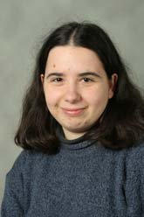
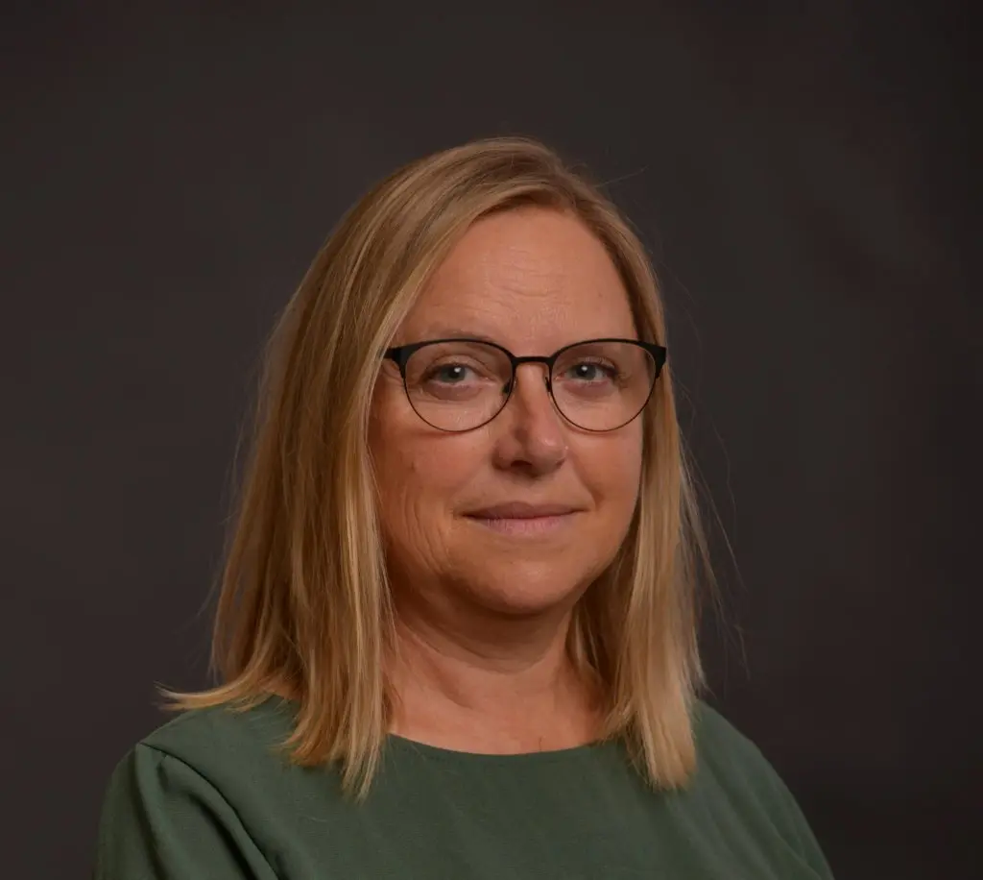
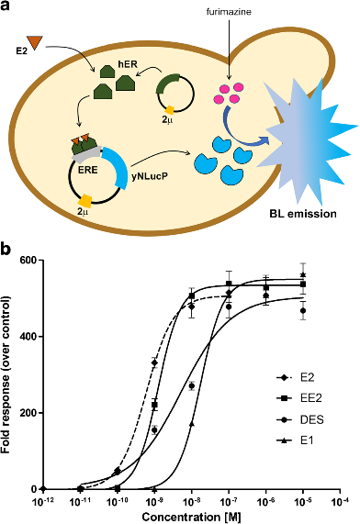
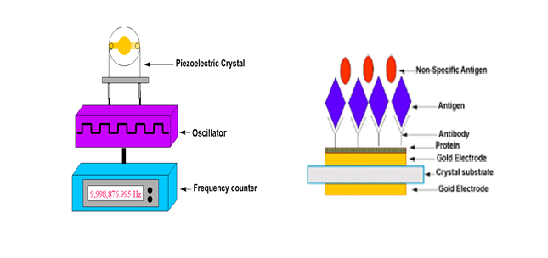
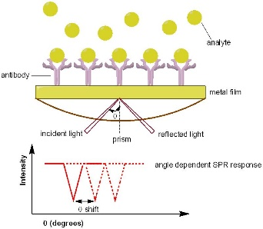

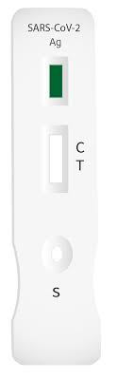
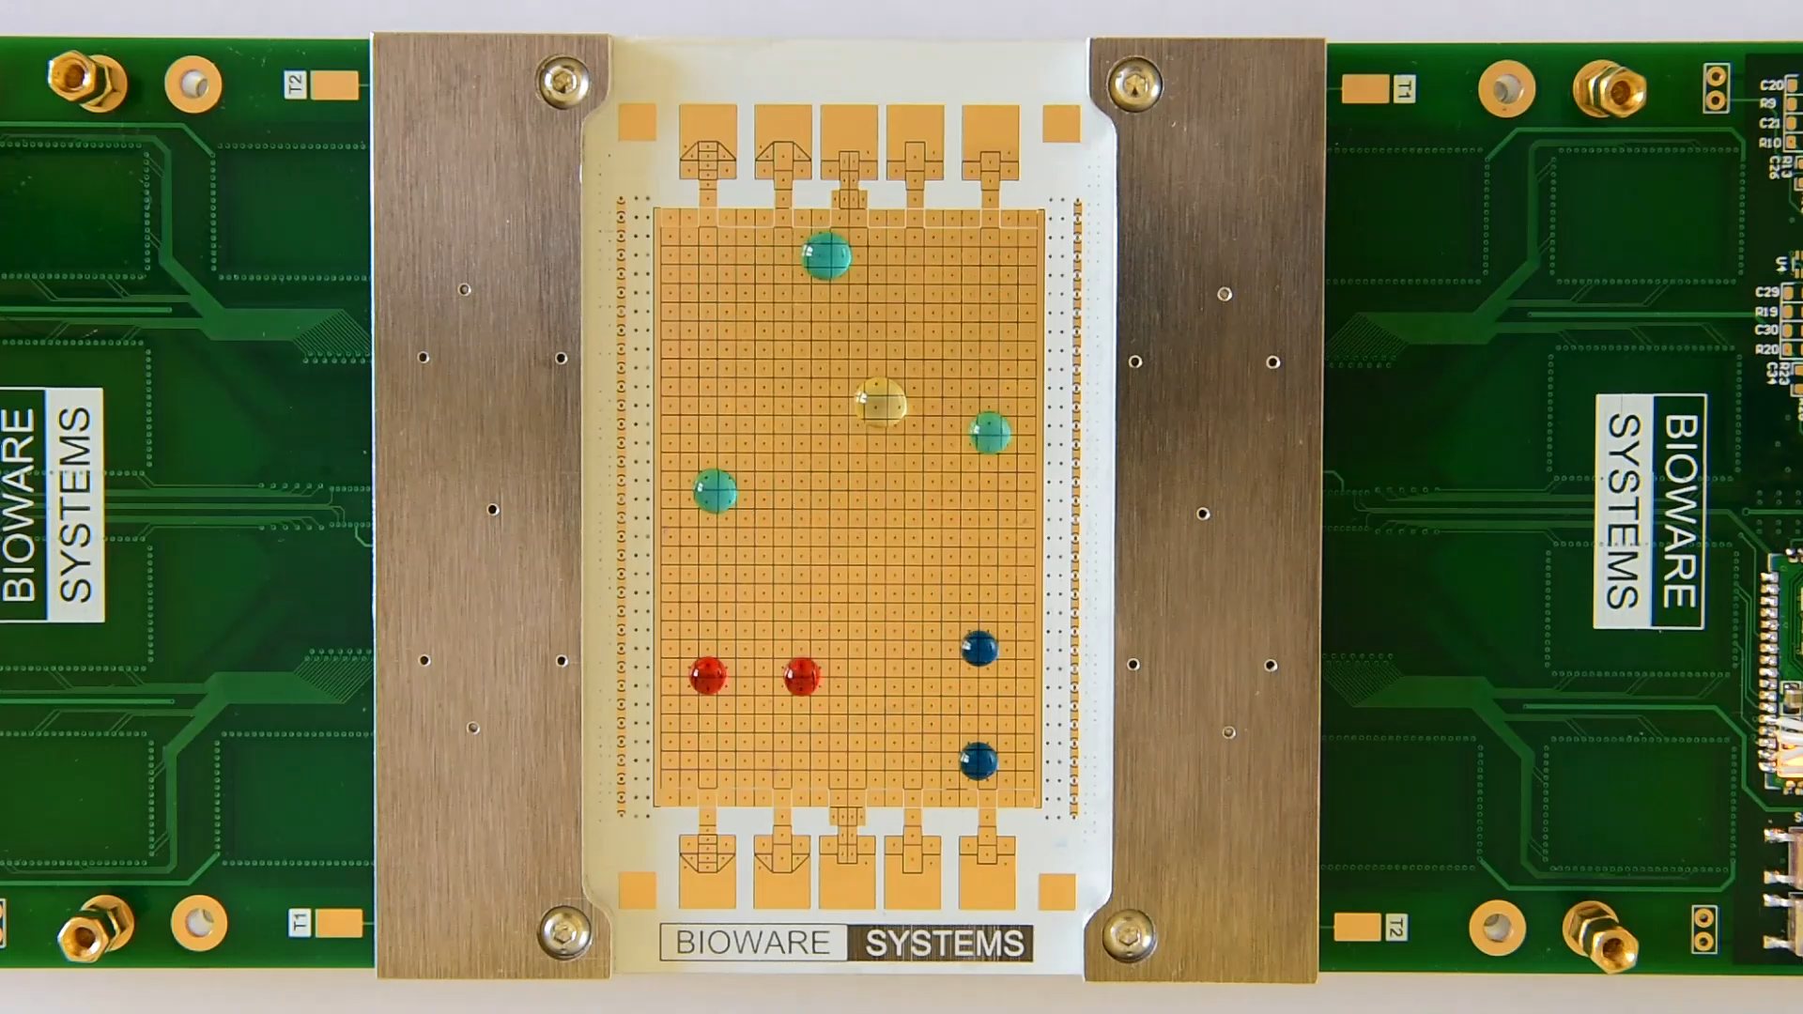
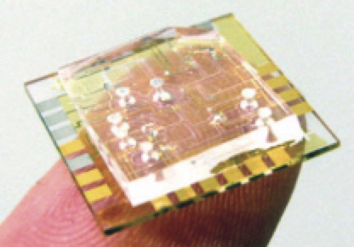
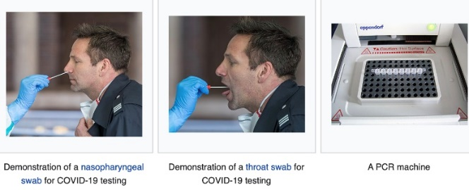
Module BED1: Maria Dimaki, Winnie
Svendsen (Bioengineering)
Biosensor design and application
Basics of biosensor and bioassays
Biorecognition elements
(enzymes, antibodies, DNA, cells)
Sensors/transducers
(electrochemical/optical/mechanical)
Integration into biosensors and systems
Diagnostic tools
wisv@dtu.dk
madi@dtu.dk
Electrode
Lateral Flow (Covid-19)
Digital microfluidics
Multiarray biosensors

Slide 14
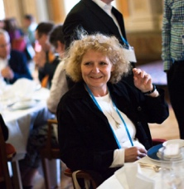
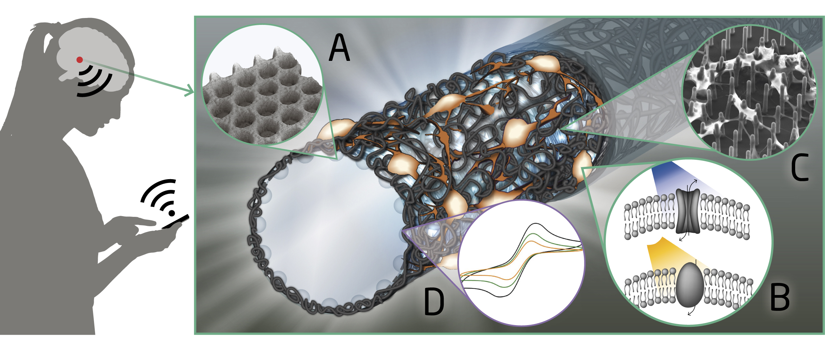
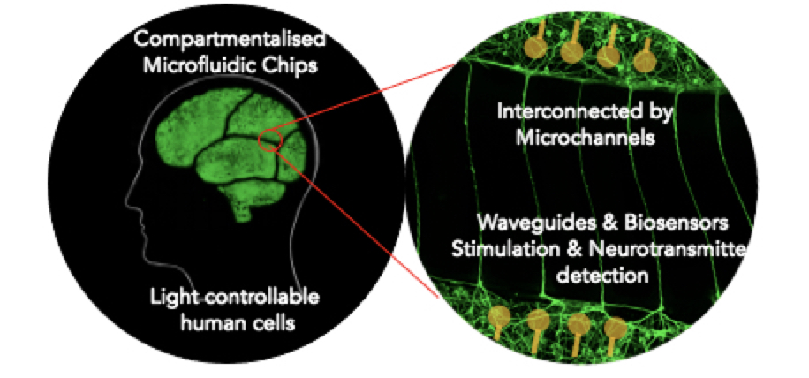
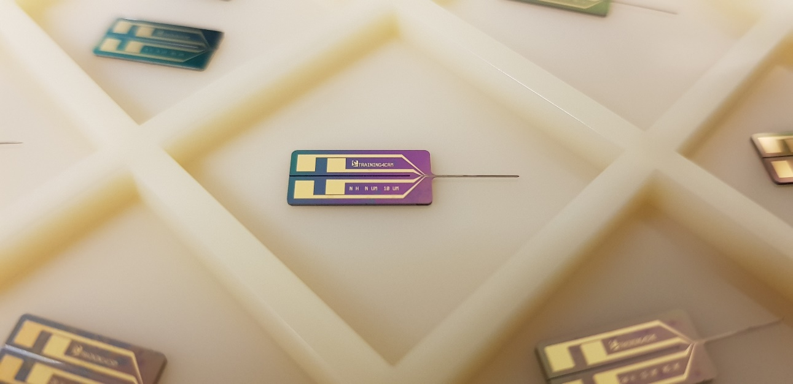
BED2+BED3– Jenny Emnéus (Bioengineering) +
Stephan S. Keller (DTU Nanolab)
Future and emerging technologies
Biofuel- and biophotovoltaic cells
Wearable systems
Functional scaffolds for 3D cell culture, drug delivery and sensing
Disease modelling systems
Brain bio implants
jemn@dtu.dk
suke@dtu.dk
Brain bioimplants
Disease modelling
Wearable biosensors

Slide 15
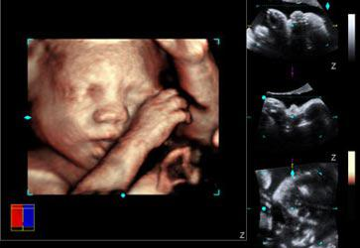
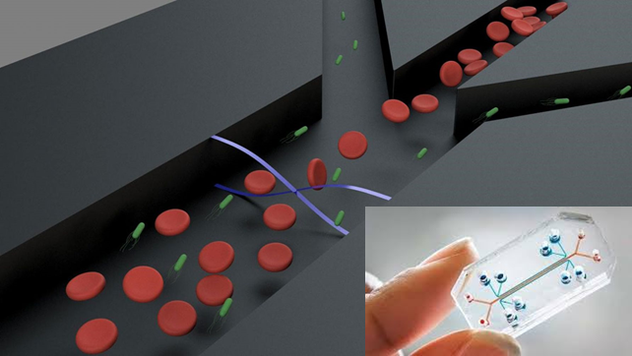
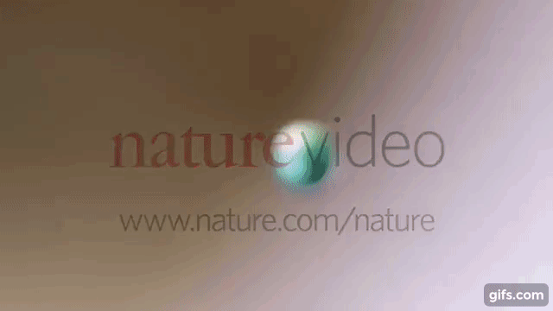
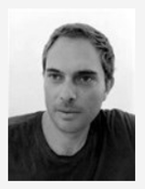
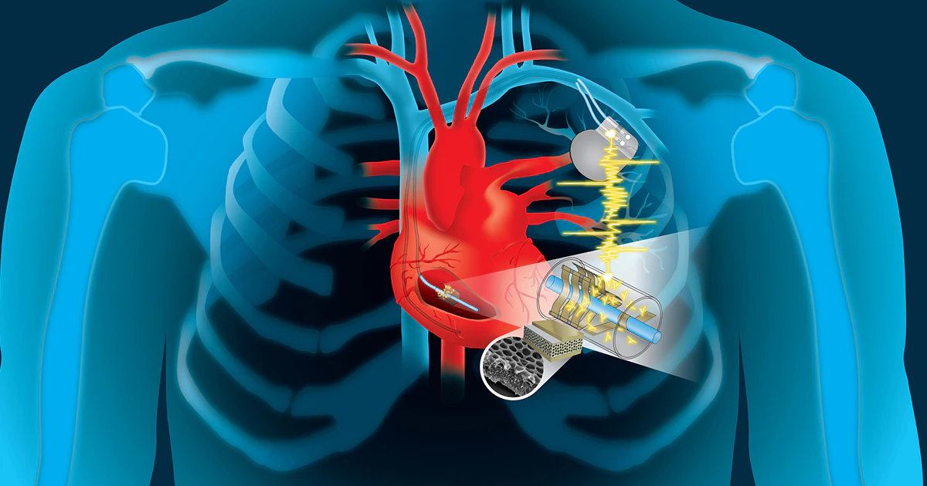
BED4 – Vincenzo Esposito (DTU Energy)
Visualization
Diagnostics and lab on chip
We look at fundamentals, applications and new trends in using materials with electromechanical functionalities for bio-medical science
Implants, prosthetic
and smart devices
Electromechanical materials and devices
Vincenzo Esposito
vies@dtu.dk

Slide 16
Biomimetics, Biomaterials, Bioinspired design track - MIM

Slide 17
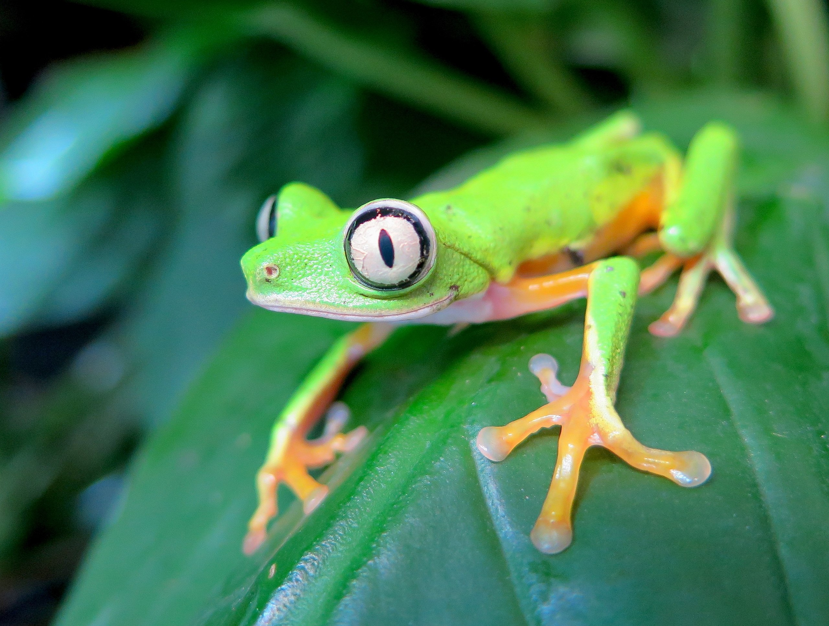
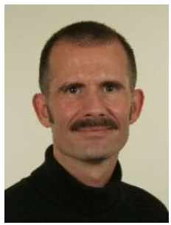
MIM1: Biomaterials & biomechanics
Technical materials vs. Biological materials
Biomaterials in medicine – body and immune responses
Biomechanics: How to move & resist impact? Fracture mechanics
MIM2: Biomimetics / Biologically inspired design
How to frame a technical problem in biological terms
How to search for biological solutions that solve the technical problem
How to communicate the findings
Torben Lenau DTU Mekanik
Torben Anker Lenau
lenau@dtu.dk

Slide 18
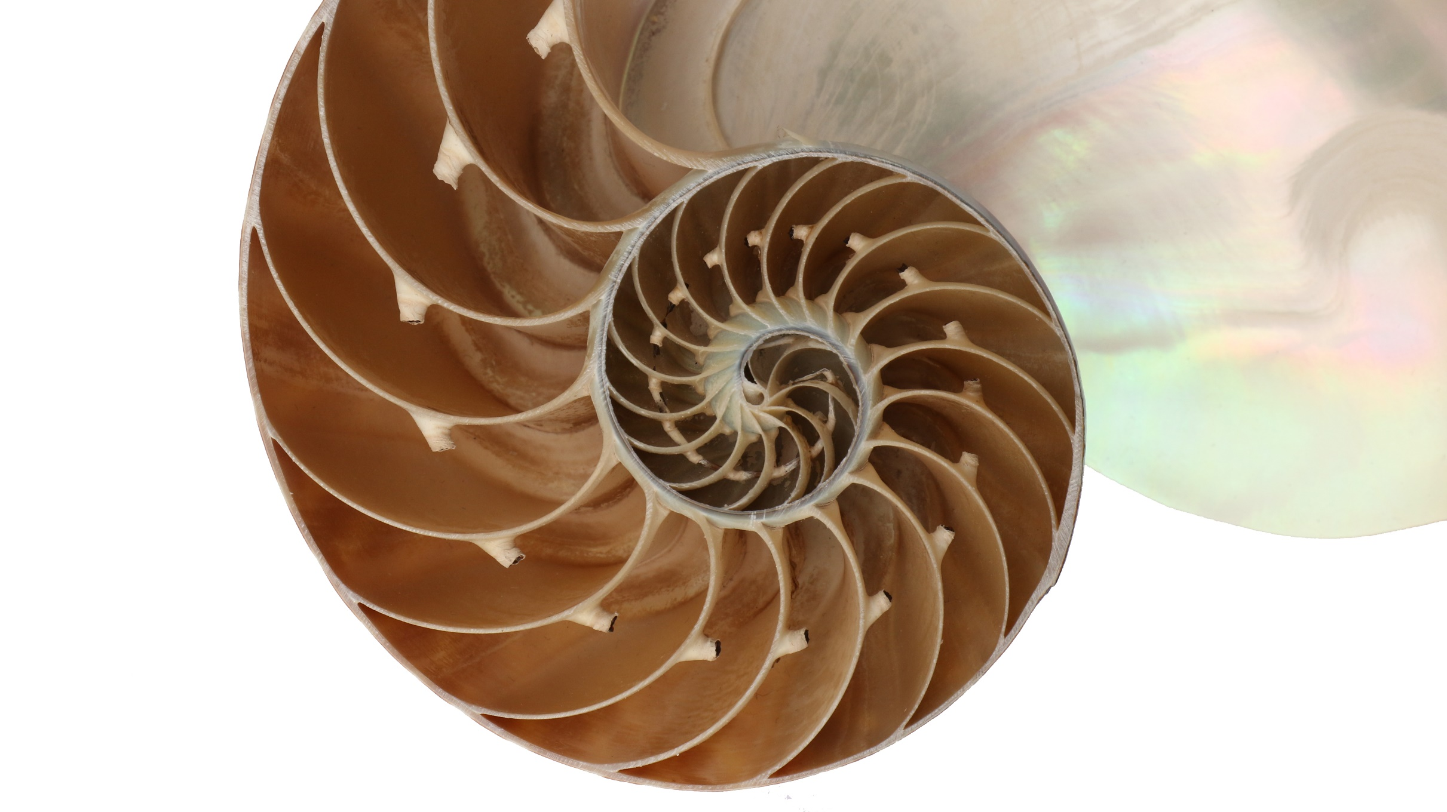
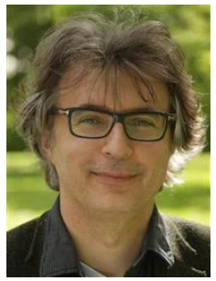
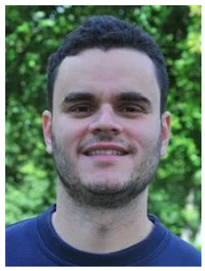
MIM3 Architecture and Construction in Nature
● Concepts of design of load-carrying structures in Nature and Engineering
● Form-finding and optimisation
● Robustness of structures
● Usage and inspiration of biological materials
● Future developments
Holger Koss
hoko@dtu.dk
Hol
ger H.
Koss
Evang
elos
Kats
Part 1: Background and Theory
Part 2: Experiment and Field Study
anos
Evangelos Katsanos
vakat@dtu.dk
Civil
Eng
ine
ering

Slide 19
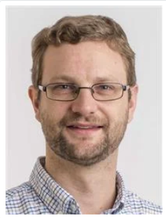
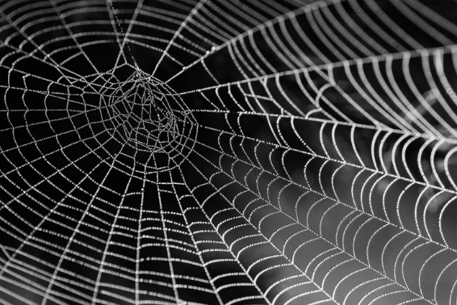
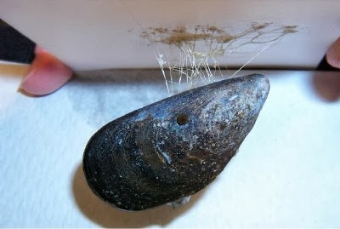
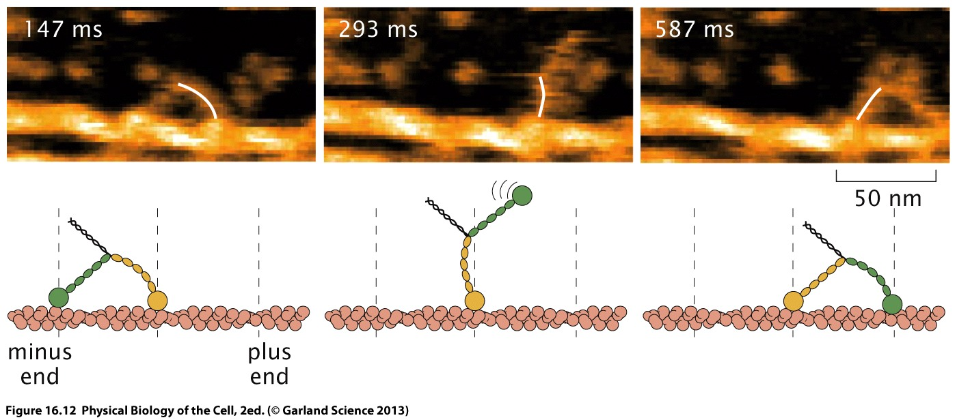
MIM4– Alexander Büll (Bioengineering)
Molecular properties and
architectures of biomaterials
Molecular motors –
engines on the nanoscale

Slide 20
Simulations and control
of biological systems track - SIM

Slide 21
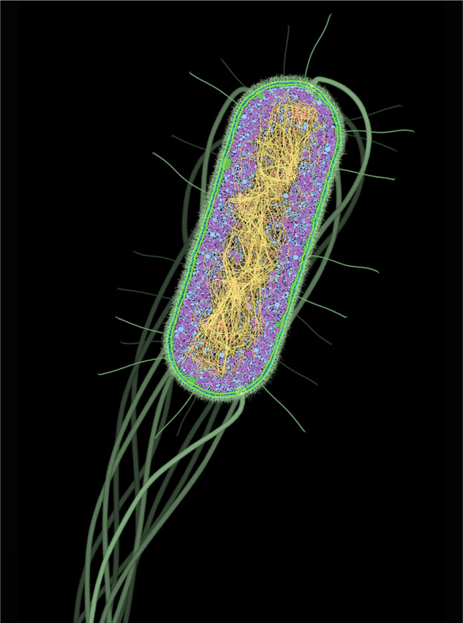
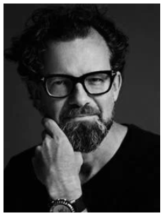
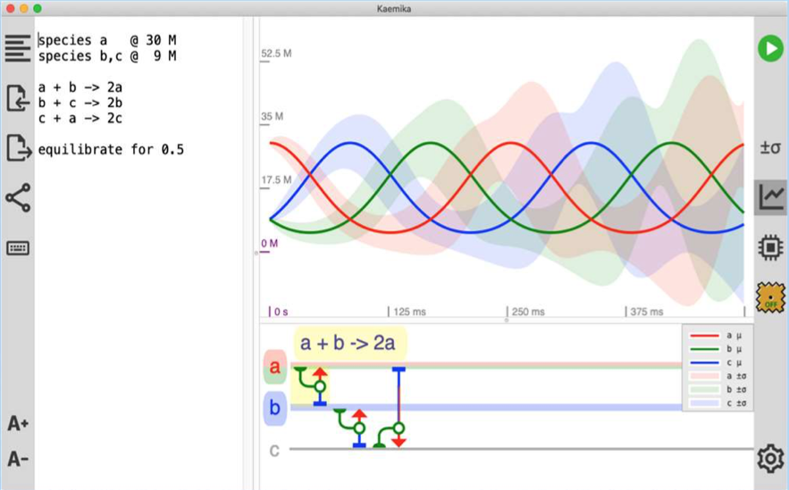
SIM1 and SIM2 Biocomputing Jan Madsen, jama@dtu.dk, B322 r114
Program:
if (A AND B) then C
In-Vivo
AACGCTAGGT
Bio Computer
In-Silico
Genetic Logic
Circuits
+
Kaemika Simulation
10011010
01101001
Notes:
,

Slide 22
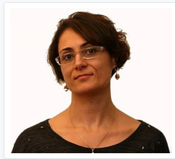
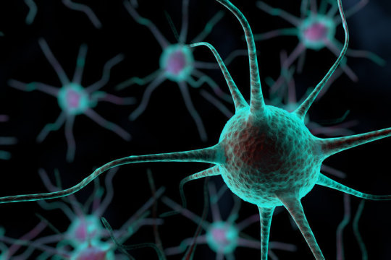
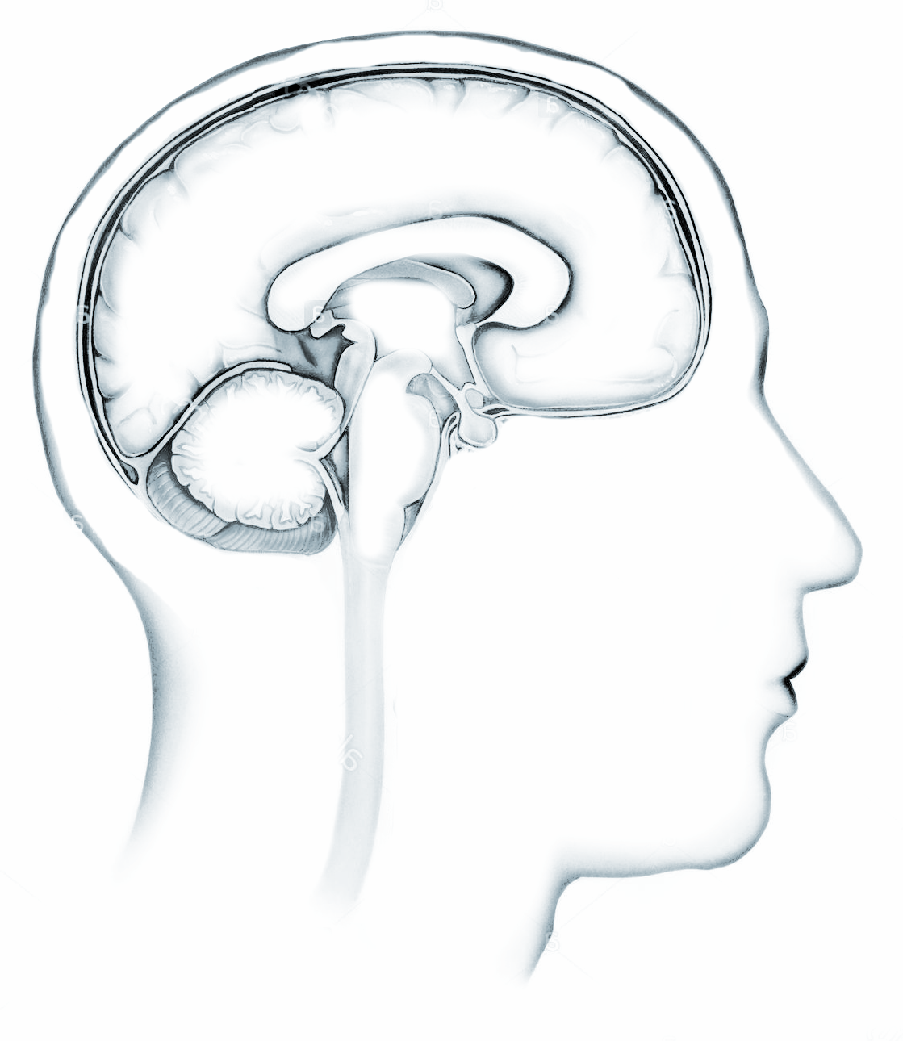

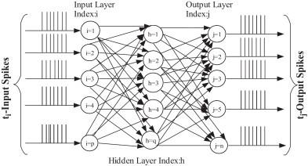
SIM3 and SIM4: MODELLING THE BRAIN
Silvia Tolu – stolu@dtu.dk – b. 326 r. 106
CC
C
Bs
SC
1st lecture: The central nervous system and neural communication
2nd lecture: Motor control
and introduction to neurorobotics
M Sys
Action
Environment
Feedback
Learning Objectives
- To explain how the function of neurons gives
rise to a complex information processing system
- To discuss how to exploit biological
principles for possible robotics applications
Neural Control
Biomimetic control architecture
Command
Sensorial Information
Notes:
This course regards three main core areas and its intersections

Slide 23
Bioengineering for the Green Transition – BFG track

Slide 24
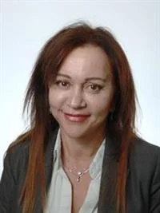
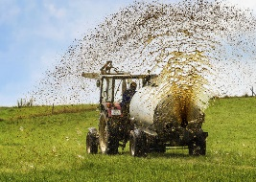
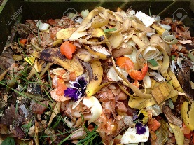
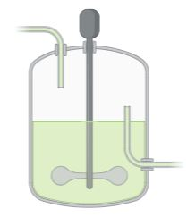
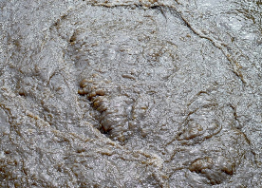

BFG1 and BFG2: Microbes serving the Green transition
Manure
SCP
Biomethane
PGP (HOB)
Biogas
Aviation Fuels
Biodiesel
Chemicals
Liquid fuels
Biopulp
Irini Angelidaki
iria@kt.dtu.dk
Sludge
Indust. Waste

Slide 25




BFG3 and BFG4: Enzyme discovery and engineering for industrial processes
Sequence mining for enzymes
Assessing enzyme structural info – from primary sequence to 3D
Enzyme engineering methods
Appplications of enzyme discovery & engineering in industry
Ditte Hededam Welner
diwel@biosustain.dtu.dk
DOI: 10.1093/oxfclm/kgad003

Slide 26
5 min break!

Slide 27
Today’s programme
- What is life and what is so special about it?
- What are the requirements for life?
- How (and why) did life start? Is life unique to earth?
How does life interact with its environment?
Physical constraints acting on living systems
- What can engineers learn from living systems?

Slide 28









What is life?
Mammal
Bacteria
Computer virus
Xenobot
Virus
Viroid
Plant
Robot
Prion
NASA: Life is a self-sustaining chemical system capable of Darwinian evolution.
But: No universally accepted definition of life!
Notes:
Key message: It is not straightforward to define life and no general agreement has been reached. Some systems show only some properties generally associated with life.

Slide 29








Characteristics of living systems (of which we all agree that they are alive)
Out of thermodynamic equilibrium, constant flux of matter and energy (metabolism), steady state, thermodynamic equilibrium = death
Appear to violate the second law of thermodynamics (but of course they do not)
Local decrease in entropy paid for by larger increase somewhere else
Evolution from simple to complex
(at least in the beginning)
Cellular organisations
Separate “inside” from “outside”
Zhou and Sazanov,
Science 2019
Notes:
Key message: Life on earth is characterized by a peculiar out of equilibrium state, evolution and cellular organization.

Slide 30



Forms of energy that life can harvest from the environment
light (photosynthesis, not at the origin of life!)
energy rich inorganic compounds (chemolithotrophy)
energy-rich organic compounds (chemoorganotrophy)
potentially gradients in chemical species and temperature in the environment
(postulated for early organisms)
Life is an interplay between anabolism (building complex molecules, use energy) and catabolism (break down complex molecules, release energy)
Pyrite - FeS₂
Notes:
Key message: The different forms of energy life can harvest.

Slide 31



How is energy stored/converted in living systems
gradients of ions (salt ions, protons)
long-lived energy rich molecules (fat, starch)
short-lived energy rich molecules (ATP, NADH)
ATP
Notes:
Key message: the ways in which energy can be stored.

Slide 32

What is energy used for by living systems?
synthesis of chemical substances
molecular movement – directed (work) and disordered (heat)
information processing and computation
Examples:
Energy efficiency of brain vs. computer/LLM
You want to know more about how the brain works? Chose the SIM track
Energy efficiency of muscles
You want to know more about how molecular machines (do) work? Chose the MIM track
Notes:
Key message: energy efficiency of living systems can be more or less efficient than that of artificial systems. Muscles are not very efficient, but the brain is still several orders of magnitude more energy efficient than the best computers.

Slide 33


The necessary conditions for (active) life
Life (as we know it) requires:
liquid water
an energy source
temperatures compatible with biomolecules
Things that may have helped for life on earth to develop, but that are probably not
strictly necessary:
a magnetic field and a dense atmosphere to protect from radiation
large gas planets in our solar system to protect us from comets, asteroids etc.
a large moon
Notes:
Key message: There are some very basic requirements to allow life as we know it.

Slide 34


The “goldilocks” zone
The position of our planet earth in the solar system is just right, like the temperature of Goldilock’s porridge…
This is no coincidence, but a manifestation of the anthropic principle.
Image: Carl Sagan Institute
Notes:
Key message: there is a habitable zone around a star, mostly defined by the possible presence of liquid water

Slide 35




What is so special about water?
Water is very polar and can form
strong interactions. It is a good
solvent for many polar substances.
Density anomaly
Could other solvents work as well? Well, maybe… ammonia, hydrogen sulfide, hydrocarbons and others have been discussed.
Notes:
Key message: Water is a very special solvent for life.

Slide 36

Water on mars?
Analysis of 4 years worth of ”mars-quakes”by the lander InSight suggests that there could be considerable quantities of liquid water deep underground (11.5-20 km under the surface). If this turns out to be true, that may be a spot to look for life!

Slide 37




Where is life found on earth?
hot springs
salt lakes
black smoker vents
deep underground
under Antarctic ice
deep sea
high in atmosphere (up to 50 km)
http://www.geologypage.com/2019/04/
what-is-a-hydrothermal-vent.html
https://www.smithsonianmag.com/travel/science-behind-yellowstones-rainbow-hot-spring-180950483/
Notes:
Key message: Life is found in the most exotic and hostile environments on earth.

Slide 38





The resilience of life
(Simple) life forms can resist:
freezing
drying
very high salt concentrations
radioactive radiation
exposure to outer space
asteroid impact
Deinococcus radiodurans
survives 3000 times the
deadly radiation dose for
humans
It is estimated that 99% of all species that
have ever existed are extinct. While individual
species can be very vulnerable. Life itself
is highly resilient.
Tardigrade
http://www.bbc.com/earth/story/20150313-the-toughest-animals-on-earth
http://www.biocision.com/uploads/docs/appnote_snapfreezing_2013.pdf
Notes:
Key message: Life, despite consisting of soft, squishy materials, is incredibly resilient against physical and chemical insult.

Slide 39


Osmosis and osmotic pressure: why is it difficult to live in the dead sea?
Pressure of ideal gas: p = (n/V) R T
Osmotic pressure (for ideal solution): Π = c R T
Notes:
Key message: Osmosis is a major physical force that life has to deal with. Osmotic pressure can be calculated like the pressure of an ideal gas.

Slide 40


How, when and where did life start?
Two scientific possibilities:
Life started here on earth, from non-living matter
(abiogenesis, only once?)
Life started somewhere else in the universe and the
earth was seeded with life from space, e.g. through
impact from comets/asteroids -> panspermia
At any rate, it is remarkable that life started on earth
almost as soon as it possibly could (determinism)…
It seems like going multicellular was harder than to
kick-start life itself…
Bell et al., PNAS 2015
Oldest rocks only ~4 billion years old,
but isotope composition (high ¹²C/¹³C
ratio) of graphite inclusions in 4.1
billion year old zircon suggests life
could have existed already back then.
Notes:
Key message: Life started almost as soon as it physically could, i.e. as soon as earth’s crust had cooled down enough

Slide 41




How has life shaped our planet?
Oxygen rise in atmosphere
initially toxic for life, due to oxidation potential
Inorganic deposits (coral reefs, chalk cliffs),
carbon recycling through plate tectonics
Deposits of organic carbon (petrol, coal)
Albedo changes
through variations in
plant cover
(c) D.Jansen
Catling et al., Sc. Adv. 2020
Alessandri et al., Environ. Res. Lett. 16 (2021) 034023
Notes:
Key message: Life is not a passive bystander, but has shaped planet earth beyond recognition

Slide 42




The chemistry of life (Miller experiment)
The graduate student Stanley Miller was the first to test whether biologically relevant products were formed under simulated conditions of the early earth (heat, 'lightning’). He used strongly reducing conditions (H₂, CH₄, NH₃) and water, and found that several amino acids were formed.
Stanley L. Miller (1930-2007)
The discharge apparatus used to conduct the experiment.
Miller S, A production of amino acids under possible primitive earth conditions, Science, 1953
Notes:
Key message: Origin of life chemistry has showed since the 1950 (and ongoing!) that the molecules of life can be formed abiotically.

Slide 43

The RNA world hypothesis
There are multiple lines of evidence that an RNA world pre-dated today’s biological world:
1) RNA stores information AND has catalytic activity
2) RNA plays a key role in all forms of life (mRNA, tRNA, ribosome, ...)
These points have led to the RNA-world hypothesis being currently the most
widely accepted theory about the origin of life.
However, the RNA world might not have been the true origin of life, but a mere
intermediate step, pre-dated by an energy metabolism.
Molecular structure of the ribosome 30S
subunit from Thermus thermophilus.
Proteins are shown in blue and the single
RNA chain in orange.
The catalytic centre that forms the peptide
bond is formed entirely of RNA.
Notes:
Key message: One possible solution to the chicken and egg problem of the origin of life is the RNA-world hypothesis, because RNA can fulfil both key functions of life, information storage and chemical catalysis.

Slide 44



The power of self-replication
Addy Pross: A new kind of stability (dynamic kinetic stability), different from thermodynamic stability, is the parameter that needs to be looked at in the context of the origin of life. How good is a chemical system in using available resources to perform autocatalytic reactions?
Addy Pross
Chemical autocatalysis is the key to understanding the emergence of life.
Different chemical systems that self-replicate and compete for the same resources will complexify.
“Normal” catalysis
Autocatalysis
Notes:
Key message: Error-prone self-replication while competing against other self-replicating systems for the same resources is the driver for complexification of life forms

Slide 45




Why did life develop?
Life represents a state of locally low entropy. Why would such a state form in a world that is governed by the second law in such a strong manner that the arrow of time is defined by it?
Possibilities:
J. Herzberg, University of Colorado
Ilya Prigogine (1917-2003) Nobel prize in Chemistry 1977
Dissipative structures are self-organising structures that are maintained through the dissipation of energy (entropy increase).
It has been postulated that life itself is a dissipative structure, and that the fundamental driving force behind its complexification is the ever-increasing efficiency of dissipating energy and maximising entropy production (see work by J. England). Life is better than non-life in resonating with external driving forces (e.g. sunlight, chemical energy) and dissipating energy.
Jeremy England
Notes:
Key message: Life behaves like a dissipative structure that creates local order but overall increases the entropy of the universe. Perhaps life is better than non-live in increasing the entropy of the universe and hence its formation is a thermodynamic imperative.

Slide 46



Life: it’s all about the information!
Basic idea: What counts as to whether or not something is “life” is not so much its
chemistry, but rather its information content and how it processes information from its environment.
Understanding of life necessitates a theory of information in the universe, from which life
should emerge naturally as a situation, where information becomes an all-determining property.
Search for other forms of life should search for complexity/information, rather than for specific
chemical signatures.
Sarah Imari Walker
Leroy (Lee) Cronin
Notes:
Key message: Life forms are information-processing systems and perhaps it’s all about the information in the end.

Slide 47
So, what is (driving the emergence of) life then?
Frankly, we don’t know…
But somehow, dissipative structures, self-replication and information play major roles in it.
Thinking about these problems, helps us get a grip on what life is, to find it elsewhere in the universe and possibly to create and engineer new life forms.
Notes:
Key message: We can currently only speculate why life exists and what drives its emergence.

Slide 48



How do we search for life in the galaxy?
https://exoplanets.nasa.gov/exep/technology/starshade/
These are formidable engineering challenges! Spectroscopy
of exoplanet atmospheres would have been considered science
fiction only 20 years ago. And now it is a reality!
https://www.physics.uu.se/research/
astronomy-and-space-physics/research/planets/exoplanet-atmospheres/
Notes:
Key message: Some even more incredible engineering goes into the search for life outside our solar system.

Slide 49

James Webb space telescope
Launched on Christmas day 2021, went operational in 2022! With significant contribution of DTU.
Will look for evidence of life through measuring the gas composition of exoplanet atmospheres
Notes:
Key message: the Webb space telescope will be transformative for our ability to search for signatures of life on exoplanets.

Slide 50

First paper with results acquired by the Webb!
What kind of atmospheres are we looking for if we want to find signs of life? Answer: out-of-equilibrium compositions, such as the simultaneous presence of methane and oxygen.

Slide 51






Slide 52
5 min break!

Slide 53



Physical constraints on life by the laws of nature
The most basic physical constraints that life has to cope with, are:
gravitational force (F scales with l³)
diffusion of substances or heat (t scales with x²)
limited available energy supply/density
fluid transport through capillarity or pressure driven flow
-> constraints on
body size of land, marine and flying animals
height of trees
size of living cells
…
http://minerva.union.edu/linthicw/transfer.htm
Examples:
Energy density of artificial vs. biological systems
J.Phys.Chem.Lett. 2013, 4, 861-865
https://savethewhales.org/report-stranded-whales/
Notes:
Key message: Life is obviously constrained by the laws of physics and the most important constraints are listed here.

Slide 54
A few notes on the importance of transport processes
The non-equilibrium nature of life implies that transport phenomena are crucial (no net transport at equilibrium).
1) transport of matter:
- nutrients in, waste products out of the cell/organism, water transport, oxygen/CO₂ transport
- matter transport can be down (favourable) or up (unfavourable) a concentration gradient, and against gravity
- Mechanisms: (electro-)diffusion, molecular motors, capillary flow, pressure-driven flow
2) Transport of energy:
linked to transport of matter (ATP, protons, sodium ions)
3) Transport of information:
Mechanisms: diffusion, molecular motors, action potential
Notes:
Key message: transport processes (matter, energy, information) are key for life

Slide 55





Transport of substances through diffusion
Diffusion occurs spontaneously down a concentration gradient, and is a statistical
process caused by the random motion of molecules. For large numbers of molecules,
the change in concentration field becomes deterministic:
Fick’s law
The diffusions coefficient D can be calculated with the Stokes-Einstein equation:
Therefore the diffusion of a particle depends on its size (R corresponds to the radius of a sphere). The diffused distance is approximately:
Diffusion through a semi-permeable membrane causes osmotic pressure!
$$\sqrt{\left\langle x^{2}\right\rangle }= \sqrt{2Dt}$$
The flux, j, is defined as the number of particles crossing a reference plane per unit time.
Notes:
Diffusion is a key transport process for life. Diffusion is ineffective on large distances, as the diffused distance grows with the square root of diffusion time.

Slide 56





Excursion: Pattern formation through reaction diffusion dynamics
Usually, molecular diffusion has an equilibrating effect, i.e. leads to a decrease in concentration gradients over time. However, coupled with reactions and in systems with unequal diffusion coefficients, stable patterns and oscillations can emerge, as first proposed by Alan Turing.
Alan Turing
Examples of Turing patterns
Such patterns and oscillations require the interplay of inhibitory and promoting functions and different diffusion coefficients. They can guide processes such as cell division and large scale pattern formation.
Raskin and De Boer, PNAS 1999

Slide 57



Fluid transport through capillarity
Water rises against the effect of gravity in thin capillaries with hydrophilic surface.
The equilibrium height (h) of the water column depends inversely on the radius of the
capillary (r₀), according to Jurin’s law:
Where γ is the surface tension, θ is the contact angle, ρ is the mass density and g is the gravitational acceleration.
$$h= \frac{2γ\cos{θ}}{ρgr_{0}}$$
Notes:
Key message: Capillarity drives the rise of water in thin tubes. This is described by Jurin’s law.

Slide 58


Transport in aqueous solution
As mentioned before, water is special; it has a high surface tension and viscosity. A key quantity to consider is the Reynolds number, the ratio of inertial to viscous forces:
where ρ is the density of the liquid, u is the flow velocity, L the characteristic length scale, µ is the dynamic viscosity of the fluid and ν is the kinematic viscosity.
At low Reynolds numbers, flow is laminar and mixing happens mostly through diffusion, which is quite inefficient over large length scales.
Example:
Swimming fish vs. bacterium
You want to know more about flow at low Reynolds numbers (aka microfluidics)? Chose the BED track!
Notes:
Key message: Flow in living systems is often governed by low Reynolds numbers – laminar flow.

Slide 59




Pressure-driven flow
When rapid transport over large distances is needed, pressure driven flow is the method of choice.
Pressure is generated by the heart muscle.
Laminar flow in a cylindrical tube is called Poiseuille flow, and it has a parabolic flow profile. Flow rate (Q) depends very strongly on tube diameter (d) for a given pressure difference: $Q=\frac{π∆pd^{4}}{128ηl}$
Where l is tube length, Δp
Is the pressure difference
And η is the viscosity.
Notes:
Key message: Pressure driven flow is necessary to supply complex large organisms with nutrients and oxygen at a high enough rate to perform rapid movement etc.

Slide 60



Universal scaling laws in biology
Despite the overwhelming diversity of biological systems, variations in many important properties (e.g. metabolic rates etc.) follow well-defined scaling relationships that can be explained by simple models based on physical constraints: $Y= Y_{0}M^{b}$ , where Y is the property of interest and M is the body mass of the animal. b is called the scaling exponent.
Based on 3 assumptions only: space-filling fractal
network, final level size invariant, energy minimized
West et al., Science 1997
Notes:
Key message: Behind the apparent diversity of biology lie some surprisingly simple scaling laws. Those can be instructive and inspiring for engineers.

Slide 61



Physical signals processed by living beings
Living systems need to process information from their environment in order to be able to maximize their chance of survival and reproduction. Physical signals that can be detected:
electromagnetic radiation (light)
pressure variations (sound)
electric and magnetic fields
chemical gradients
temperature changes
Nobel prize 2021: heat sensitive ion channel proteins, David Julius
Proposed mechanism for sensing the magnetic field by migrating birds, the radical pair mechanism.
Other proposed mechanisms include magnetite crystals in bird’s beaks.
Chemotaxis
Notes:
Life has developed sensory organs/functions for all conceivable physical signals, with sometimes astounding sensitivity.

Slide 62

What can we learn from Biology? How can we use biology?
billions of years of evolution, adaptability to new environments
all that biochemistry, catalysis, enzymes
(robotic) movement
resilience to various types of stress (heat, chemical, radiation)
aerodynamics, hydrodynamics
materials, construction designs
circular economy, biodegradation (death)
self-assembly (bottom up, not top down)
self-healing, fighting disease
sensing
intelligence, learning
You want to know more about how Bioengineering can help the green transition? Chose the BFG track!
Bio-inspiration and bio-engineering will play key roles
in addressing humanity’s challenges and achieving the
UNSDs. DTU (Bioengineering) is committed to these goals!
Notes:
Key message: Engineers can draw much inspiration from biology to solve some of our most pressing problems.

Slide 63





Top down vs. bottom up
energy
building
blocks
Image Credit: Andrey Armyagov
Image credit: Thierry Berrod
Self-assembly = no requirement of external control. Structures are encoded in molecular properties.
forbes.com
Notes:
Key message: Biology uses self-assembly (bottom up assembly) and classical engineering uses top down approaches.

Slide 64





The engineering approach vs. evolution
Evolution =
Random walk on a fitness landscape
https://timeandtidewatches.com
https://boammaaruri.blog
“Now it is not too much to say that if an optician wanted to sell me an instrument which had all
these defects, I should think myself quite justified in blaming his carelessness in the strongest
terms, and giving him back his instrument.” Hermann v. Helmholtz on the human eye
Notes:
Key message: Evolution acts as a “blind watchmaker”, tinkering with functionalities at random and only occasionally improving something. A human engineer will usually aim for a complete understanding of a given system before making modifications.

Slide 65



The future of (human) evolution
Musk, Hawking:
Our only chance of survival is to become an
interplanetary species
But: Do we really want to go there?
Are we going to find a better place
than our earth?
Never in human history have we been more destructive to our ecosystem,
but at the same time, never before have we had so much knowledge and
insight into the workings of nature. We are even close to taking our
evolution into our own hands!
Let’s use this knowledge to maintain our home in a livable state, and
continue to improve the human condition!
Pale Blue Dot is a photograph of planet Earth taken on February 14, 1990,
by the Voyager 1 space probe from a record distance of about 6 billion
kilometers (3.7 billion miles, 40.5 AU)
Notes:
Key message: Our tremendous technological prowess gives us a responsibility as well as the tools to preserve our earth in a habitable state for the generations to come.

